Slide 1

CSE3020 : PRODUCT DEFINITION AND VALIDATION
BillBook - Billing Pattern made simple!
19BCE7490 – Talasila Sri Harsha
19BCN7062 – Abhipray Adhik Chavan
19BCE7097 – Neha Chowdary
Group-4
Guided By: Dr. Hussain Syed

Slide 2
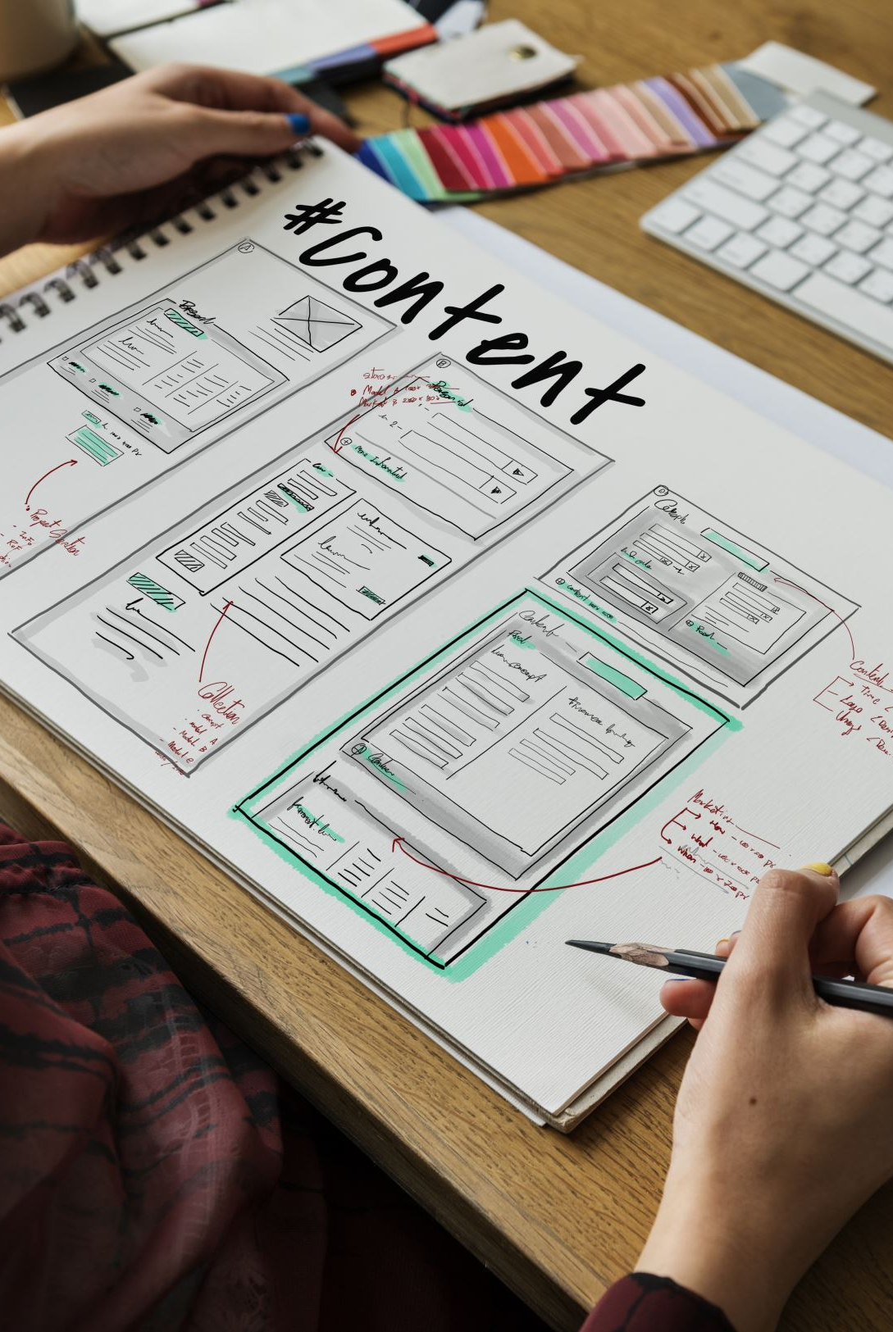
CONTENT
Motivation
Project Features
Tools & Technologies
Methodology
Modules
Future Scope

Slide 3
MOTIVATION
The main motivation of this project is to generate and manage invoices in a matter of seconds in order to avoid a lot of paperwork and time-consuming processes associated with manually managing large amounts of data.
This project benefits both business owners and customers.
This software allows the owner to maintain all products with their shorthand notation by providing summary reports, which provides a convenient solution to the billing pattern with Secured User Authentication and Validation.
And also, user Giveaway generator whenever offers, or discounts are available.

Slide 4
FEATURES OF THE APP
Generating and Managing Invoices in a matter of few seconds.
Maintain all the products with their shorthand notation.
Provides summary reports to owners monthly or weekly & yearly.
Provides a convenient solution to the billing pattern.
Make an easy-to-use environment for owners and customers.
Secured User Authentication and Validation.
User Giveaway generator

Slide 5







TOOLS AND TECHNOLOGIES

Slide 6
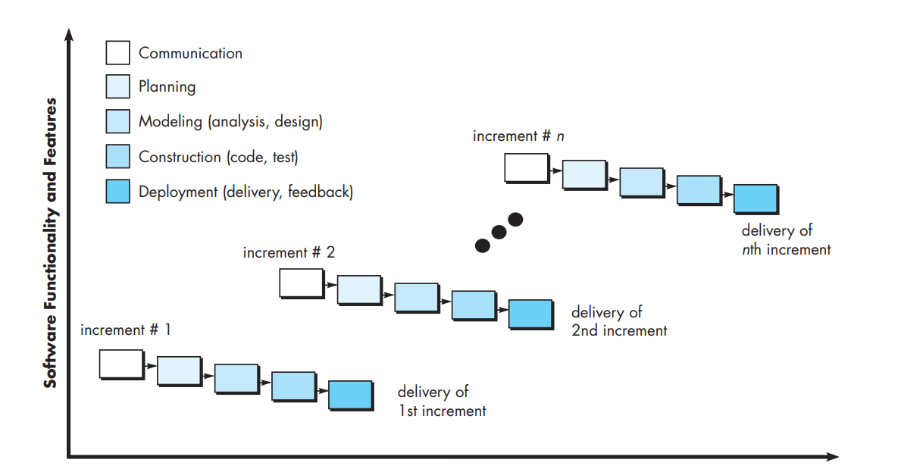
METHODOLOGY
Incremental model

Slide 7

Anyone who owns a department store and wants to utilize this WEB-BASED BILLING SOFTWARE must first sign up for the application.
The owner can create a bill for current items or add new products using the product shorthand page and other operations after joining up with an authenticated email address and password.
The administrator can monitor and contact the registered department store owners who have registered using this application.

Slide 8
MODULES
Account creation module - Sign in, Sign up
Bill Generation module - Create, Read, Update, Save
Report Generation module - Print, Download
Bill Calculation Module - Math, computation
Admin module - Managing user modules
Product Shorthand notation module
Random giveaway generator module
Logout module - Session Delete

Slide 9
FUTURE SCOPE
The application is made to keep track of data from a wide range of businesses.
Order confirmation invoices to customer’s devices.
Provides an easy billing pattern solution.
Bill/Invoice creation is instantaneous.
On a regular basis, generates report summaries for the owners.
At times, a user-giveaway feature will be planned with a bill / invoice generation.

Slide 10
THANK YOU

